Slide 1
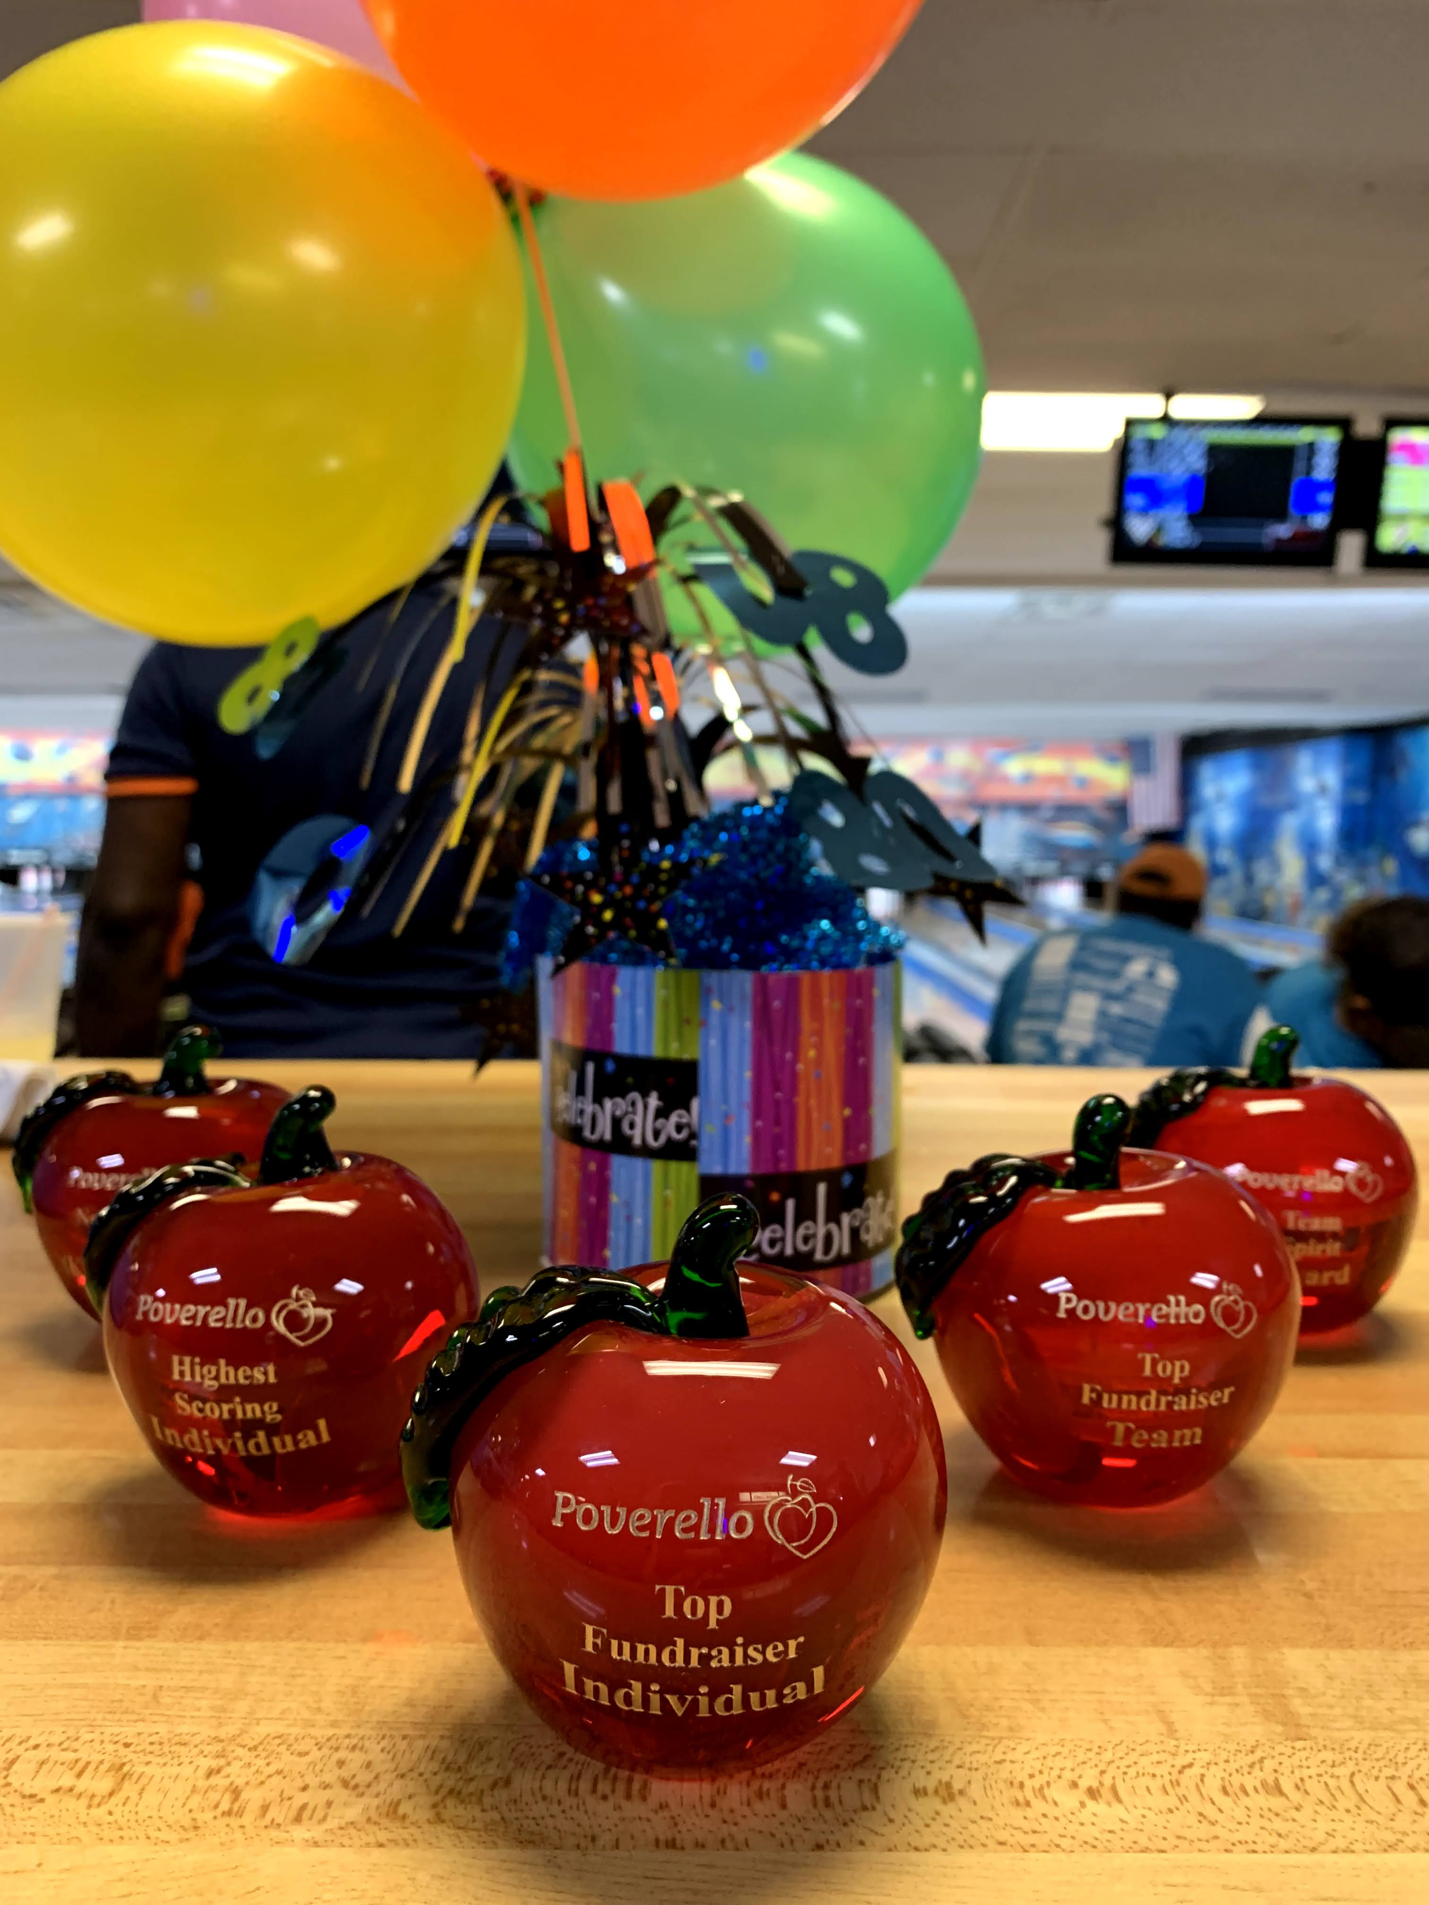
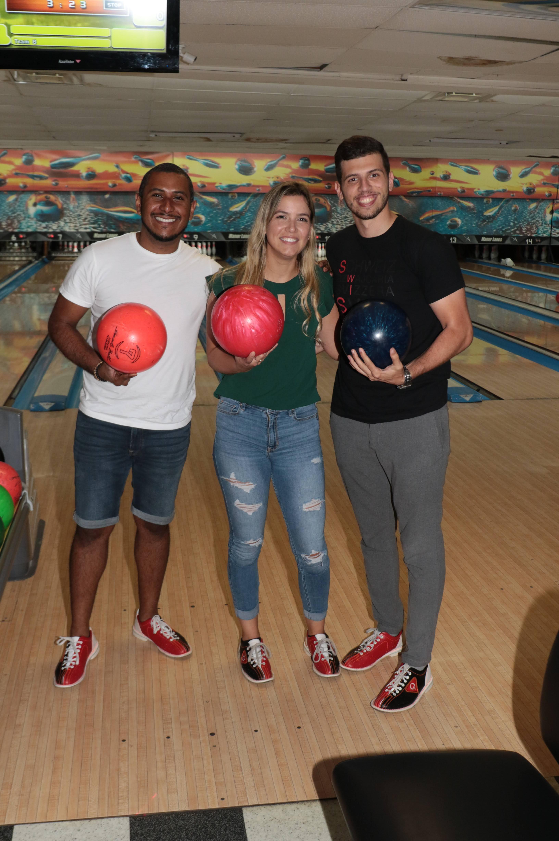
Bowling for food as Medicine
35 Years of Caring for South Floridians in Need

Slide 2
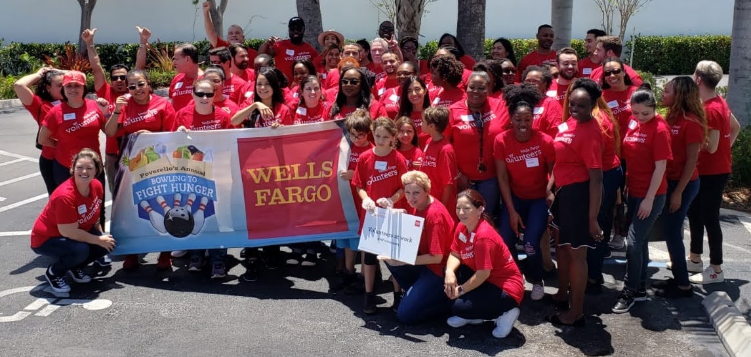
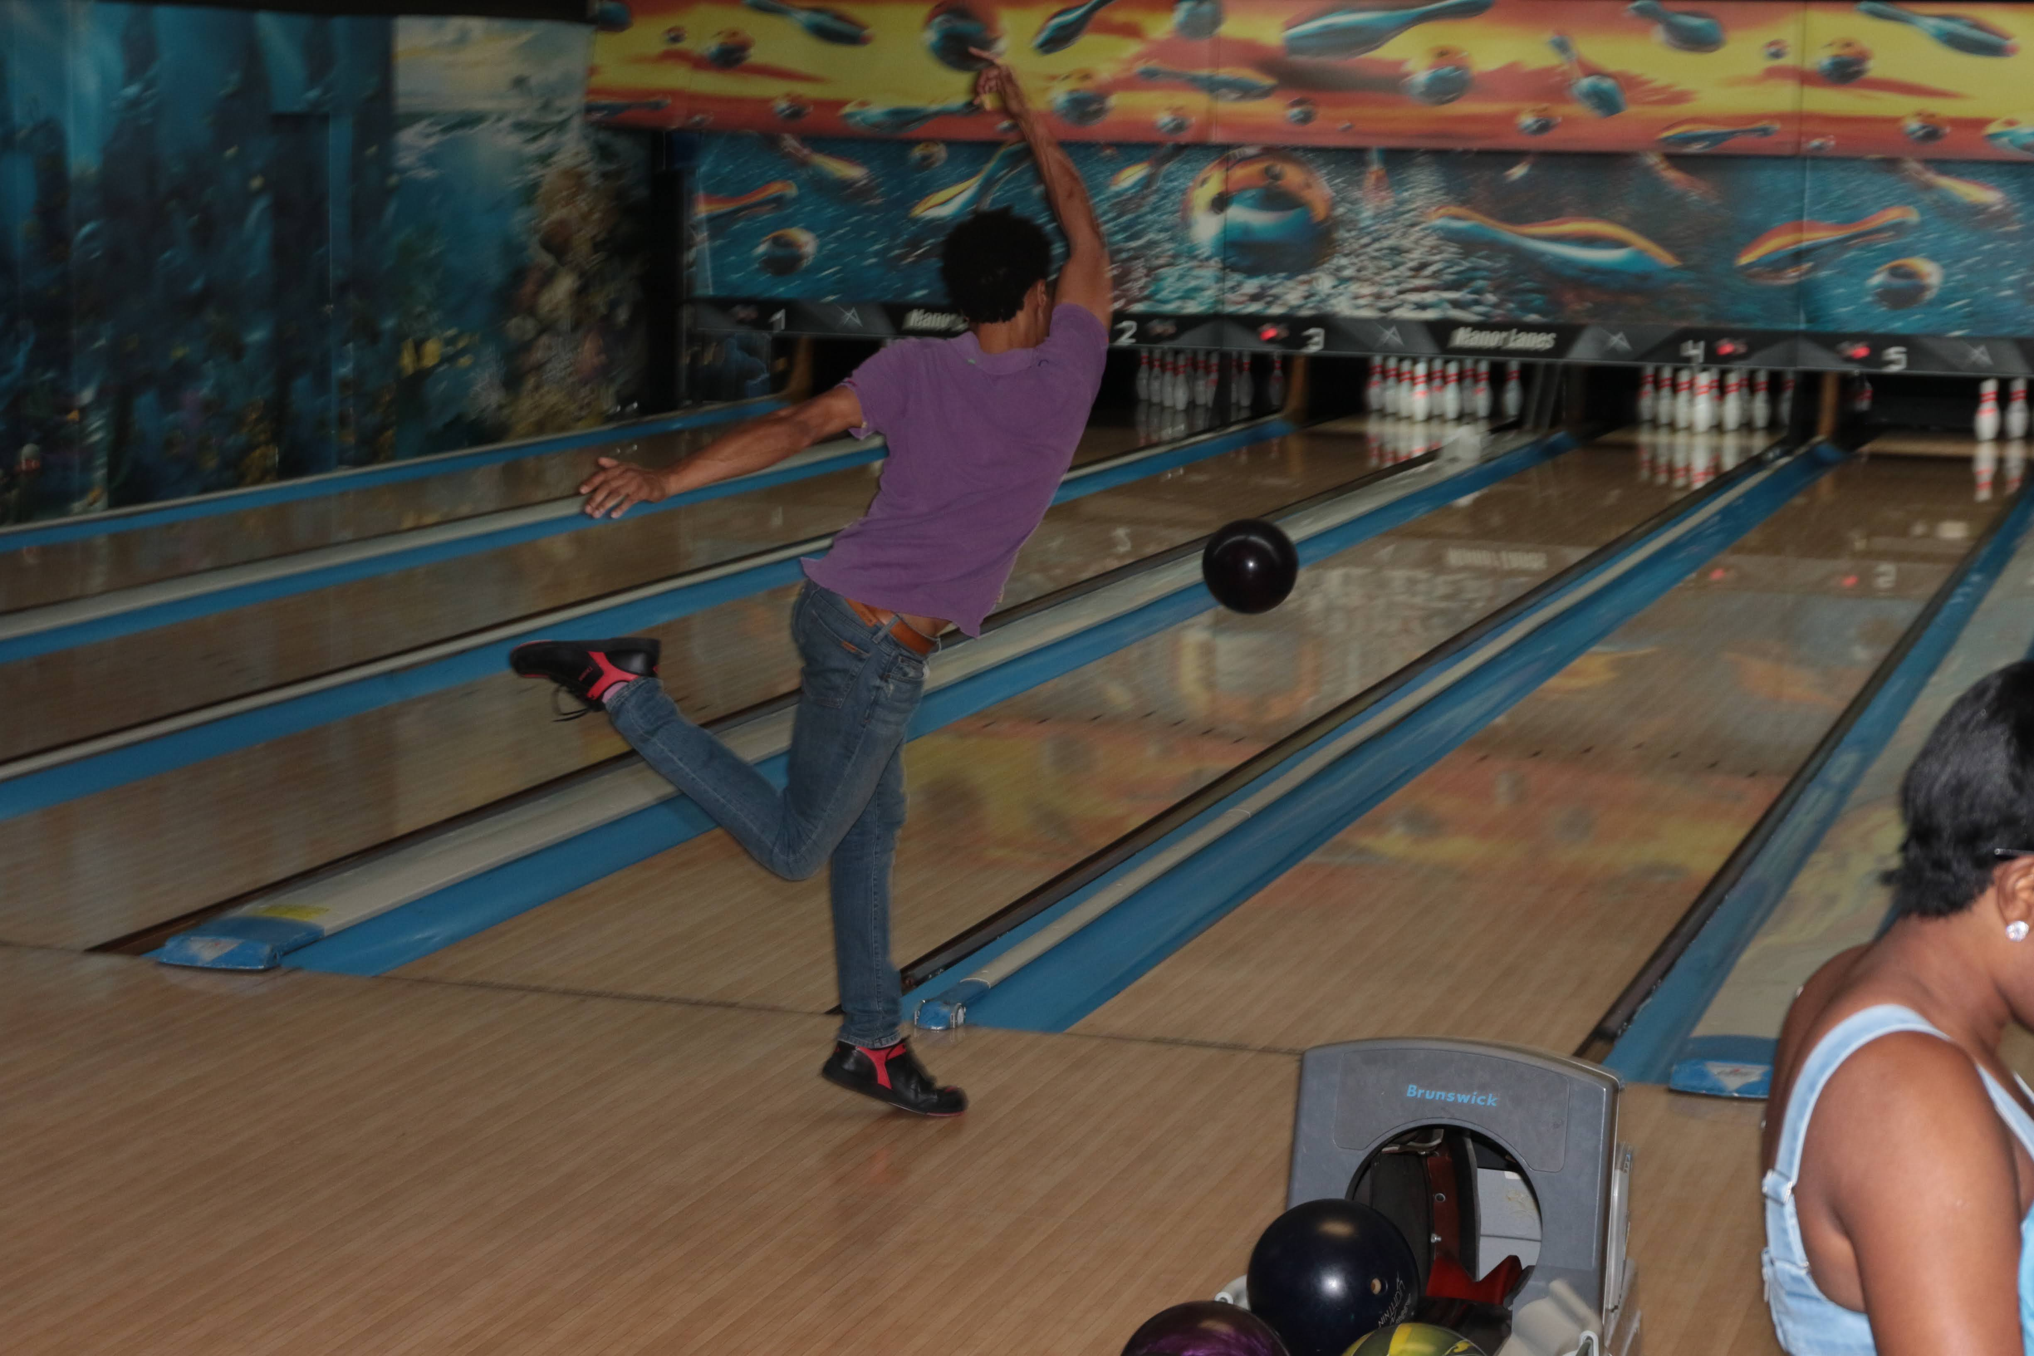
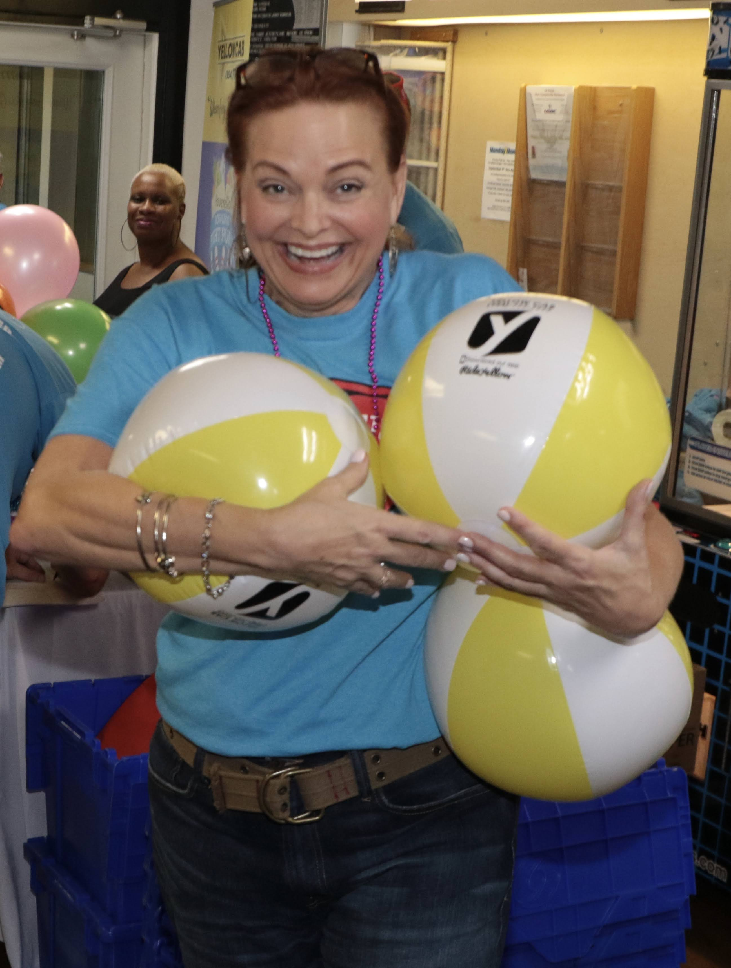
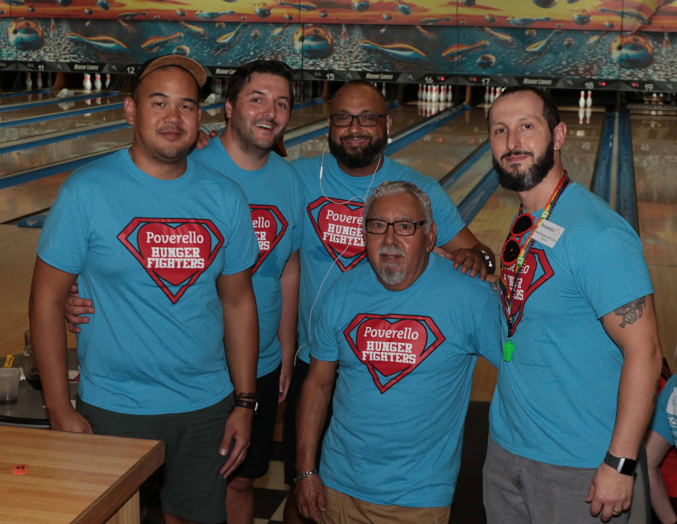
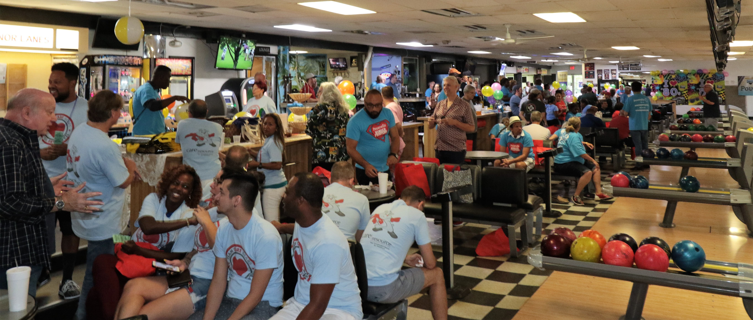
Event Schedule
January 13, 2023
Manor Lanes Bowling/Sports Den Pub, 1517 NE 26th St, Fort Lauderdale, Florida 33305
2 Shifts:
Shift One 11:00AM- 1:30 PM
Host Program & 2nd Registration 1:30PM – 2:00 PM
Shift Two 2:00 PM – 4:30 PM

Slide 3
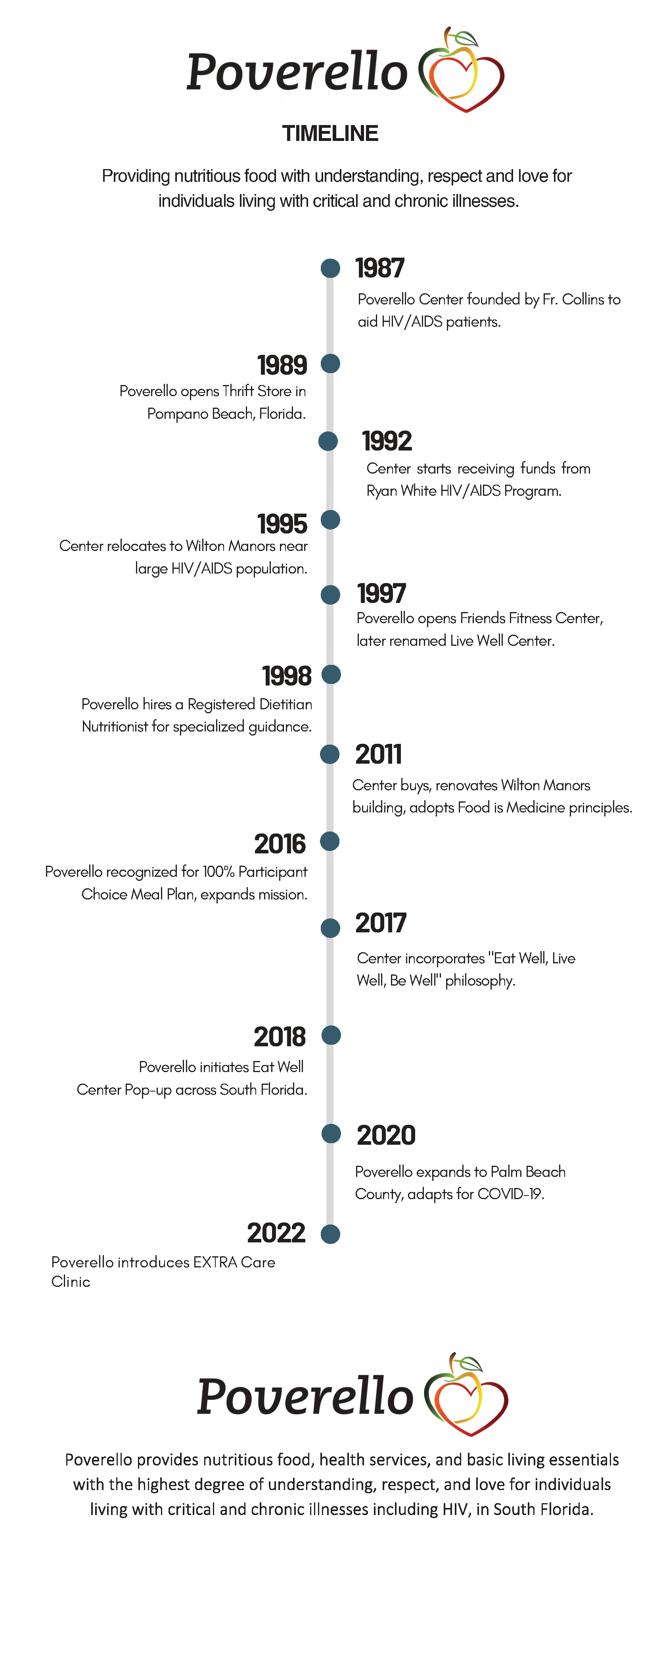
A BRIEF history
EAT, LIVE, & BE WELL

Slide 4
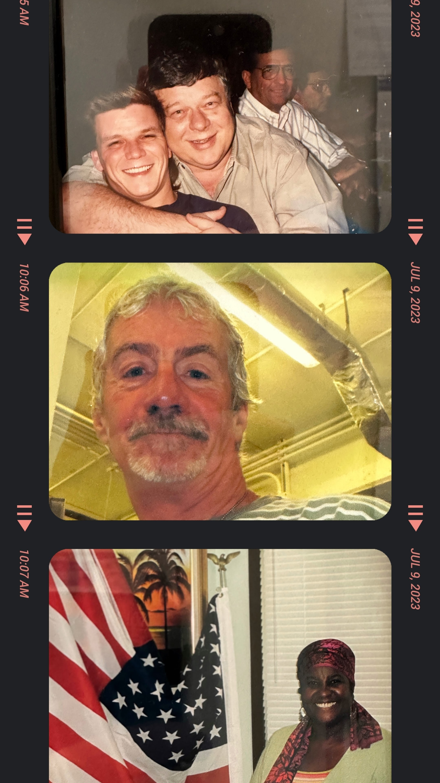
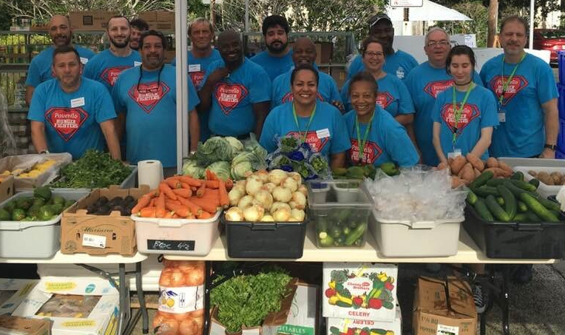
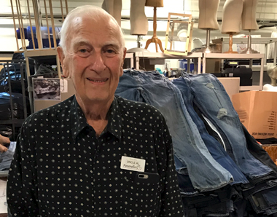
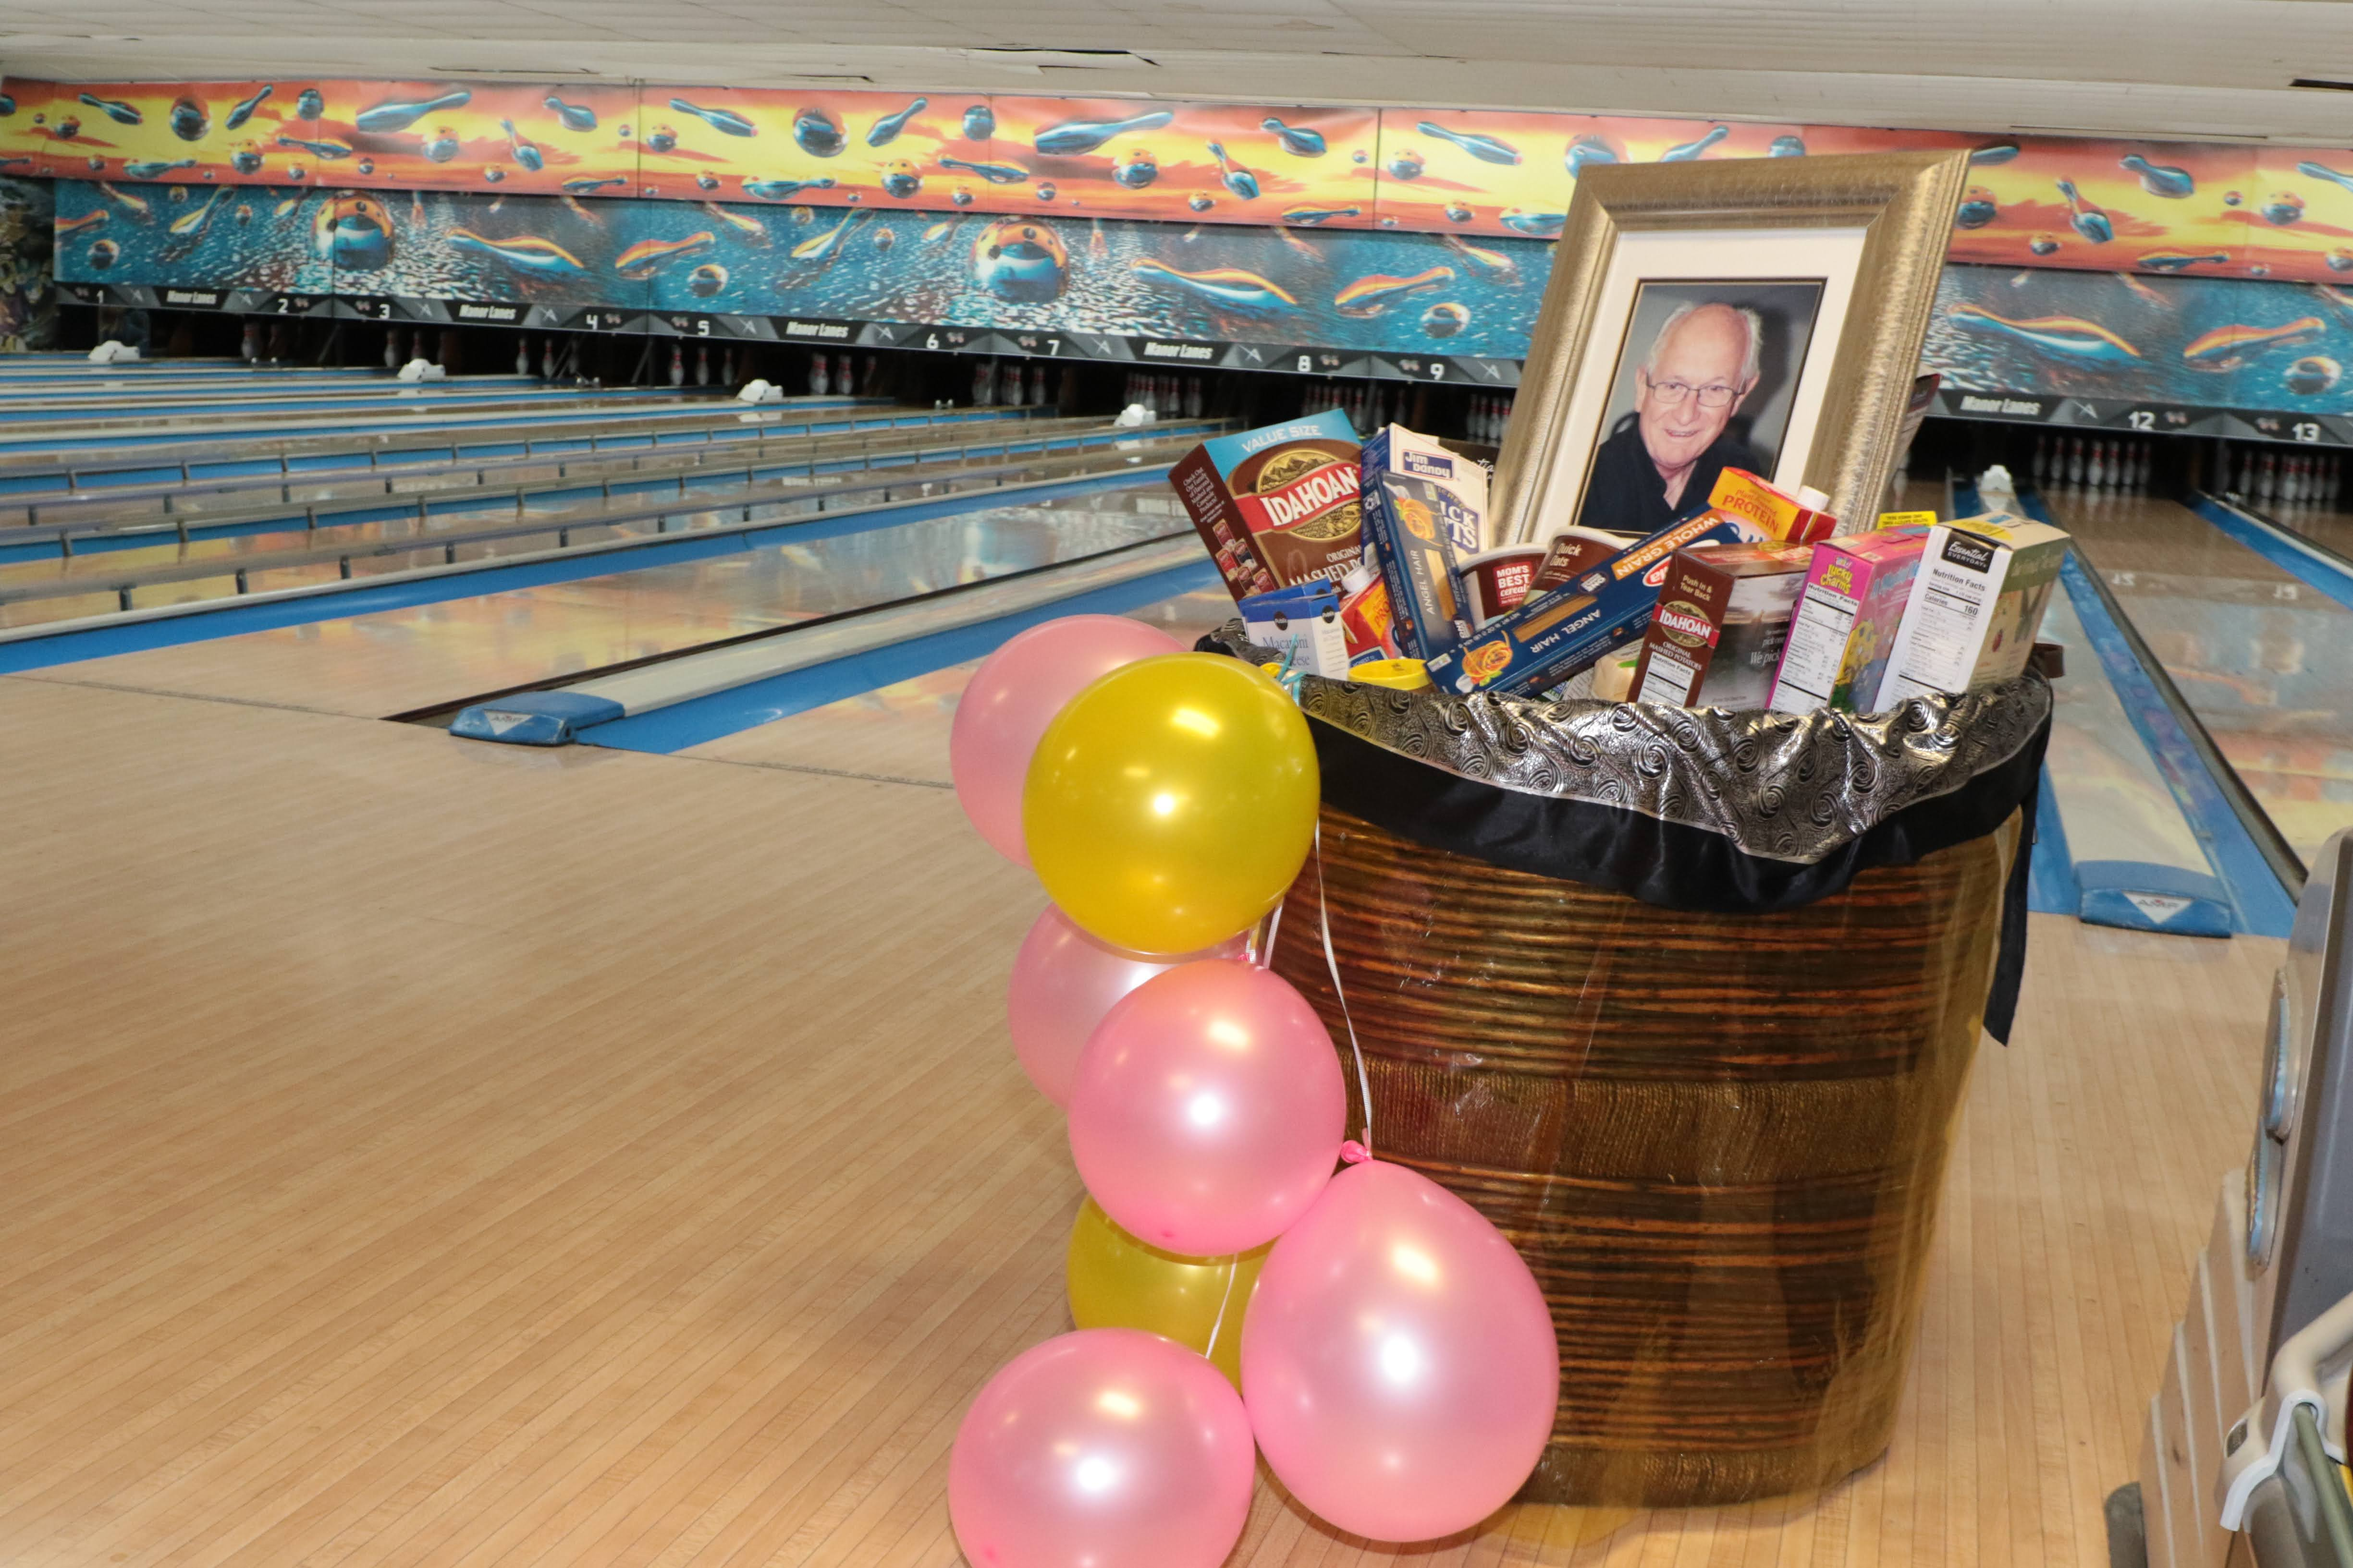
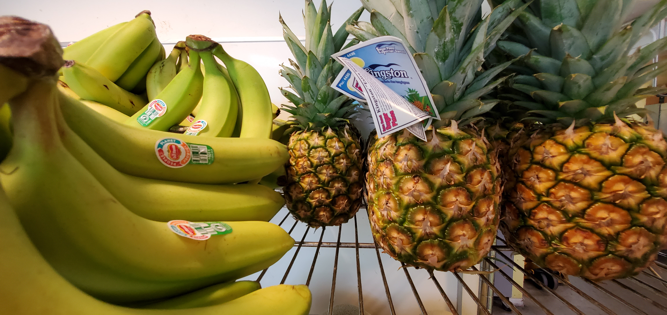
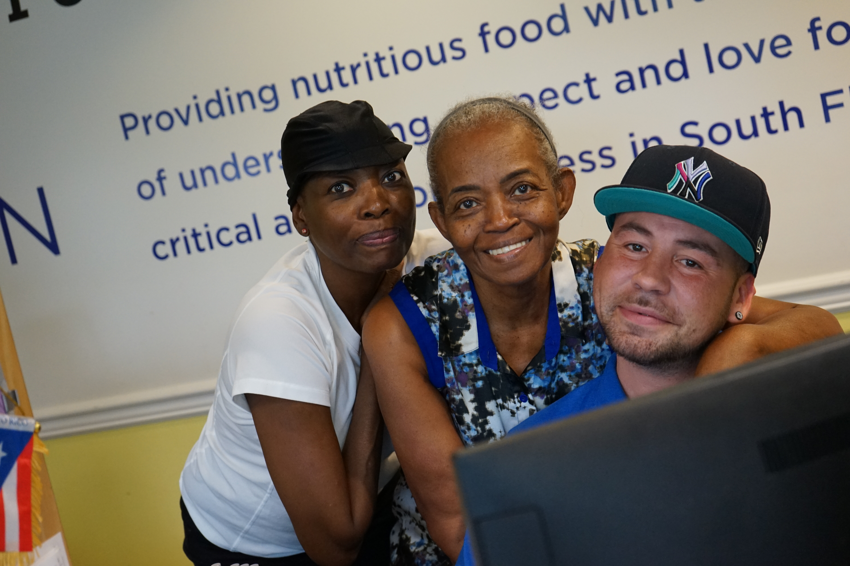
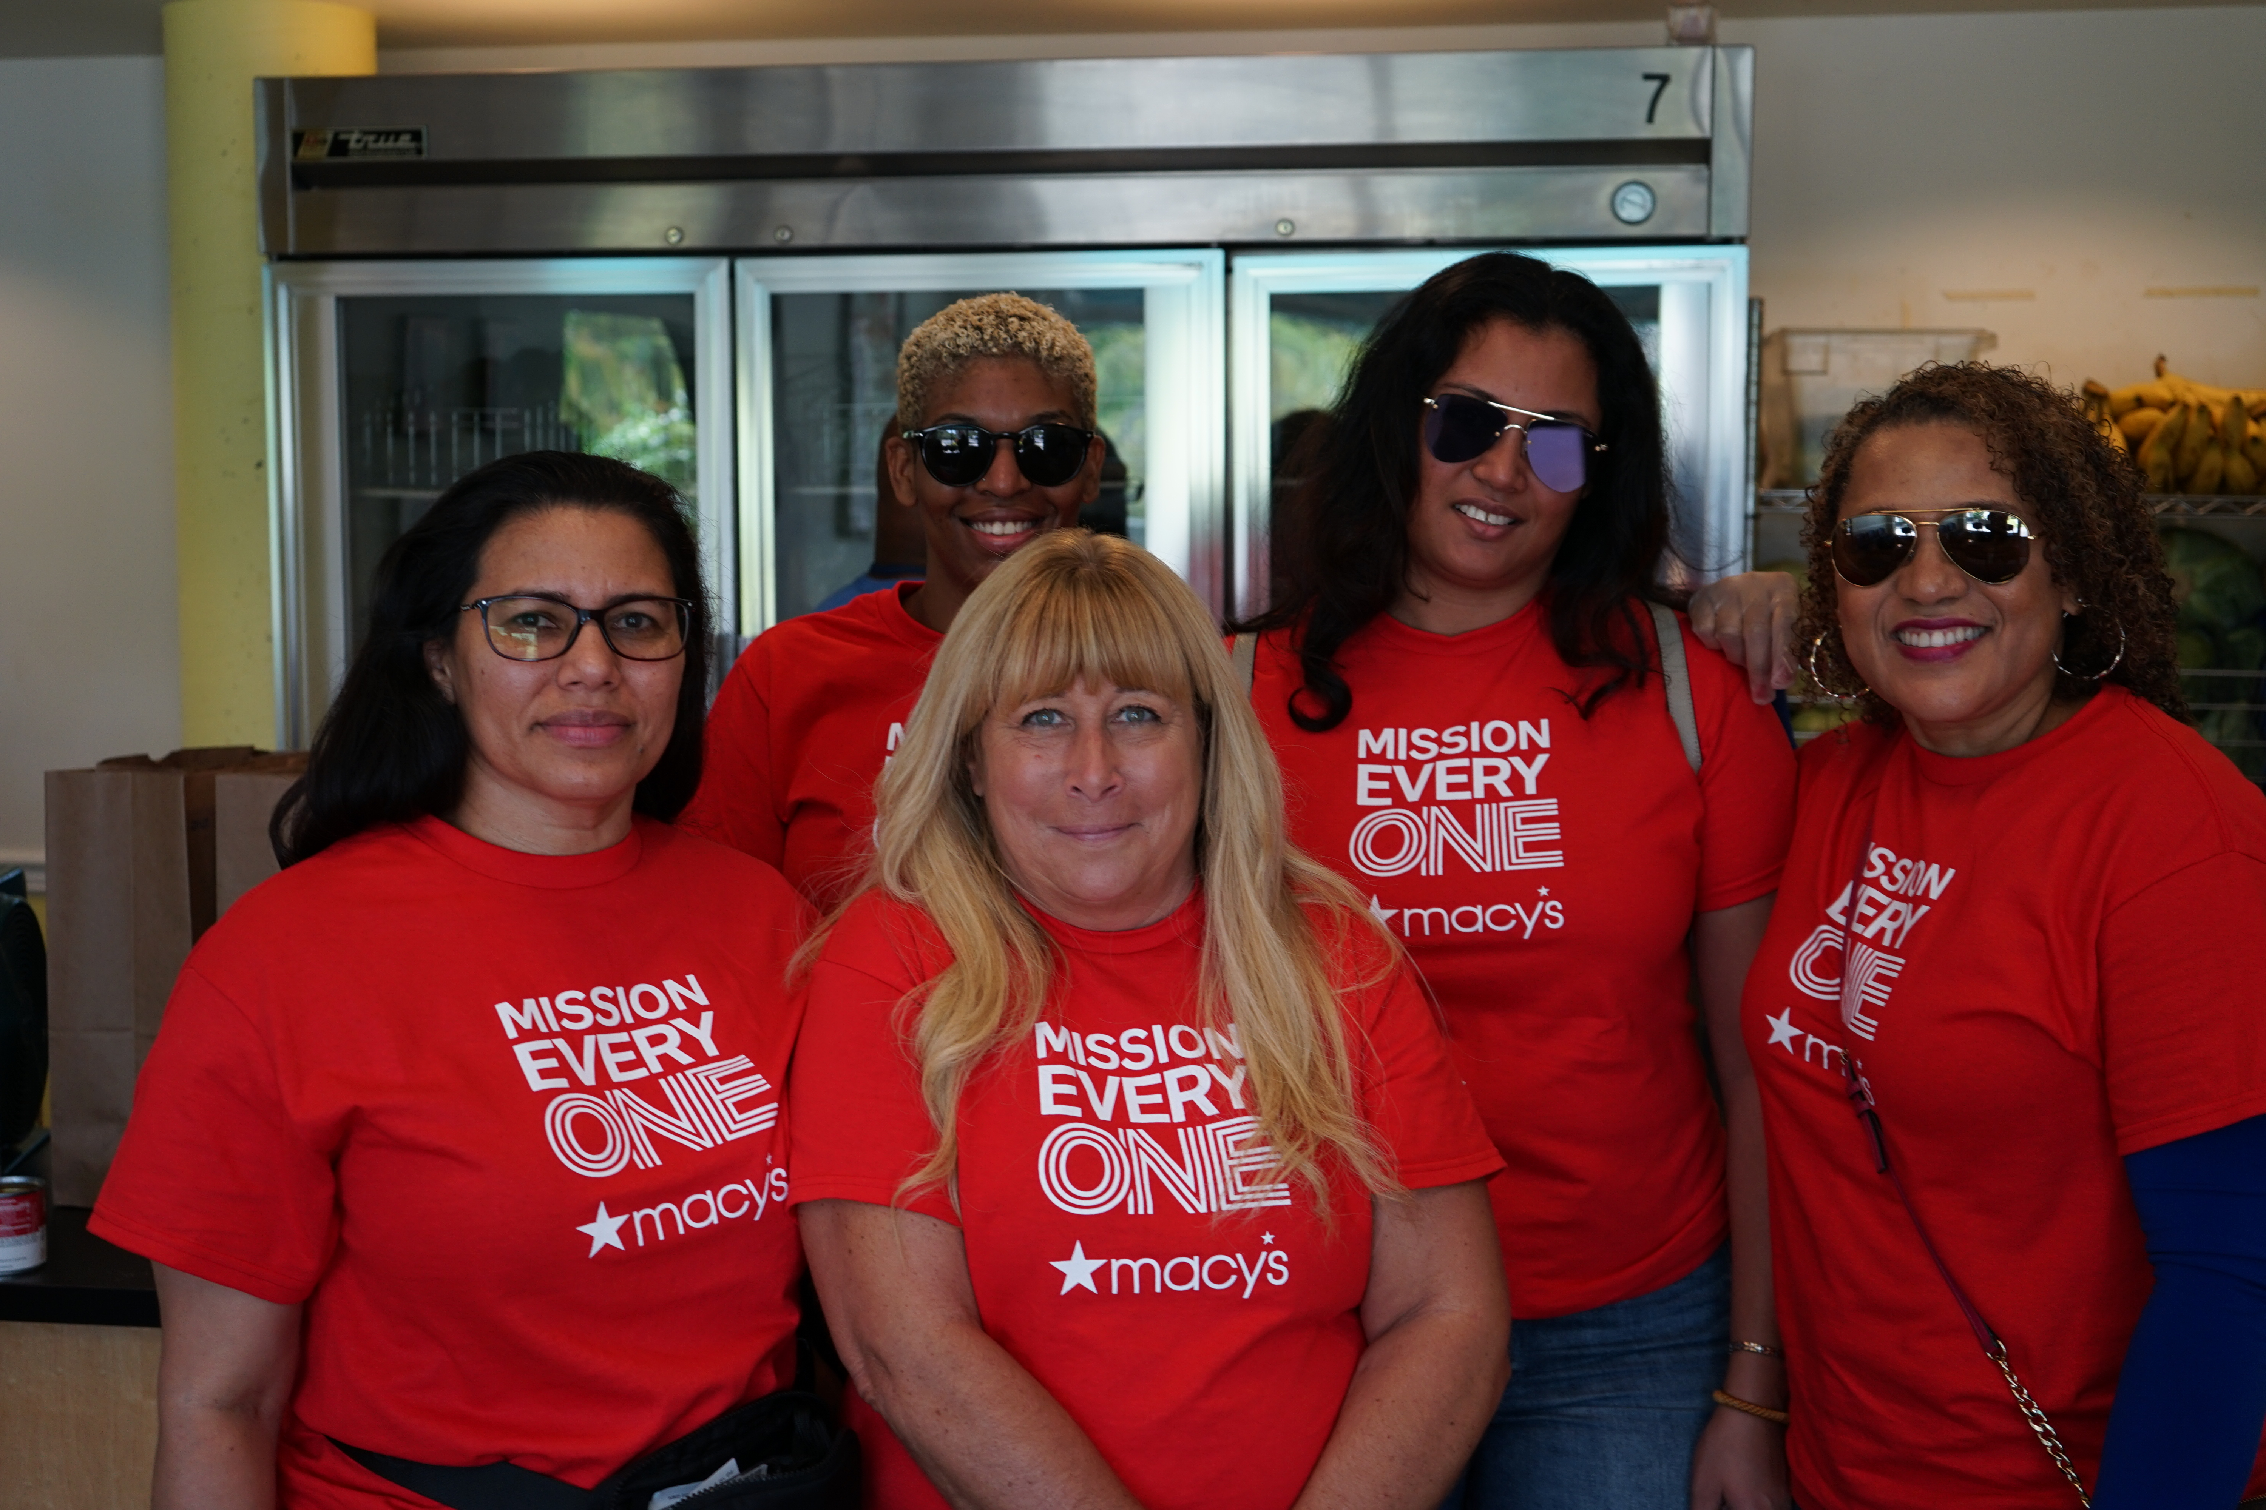
Founded in 1987 by Fr. William "Bill" Collins, the Poverello Center has been a cornerstone in providing comprehensive care for individuals affected by HIV/AIDS and other chronic illnesses. Initially focused on meeting the overlooked needs of discharged HIV/AIDS patients, the center quickly expanded its offerings. Milestones include the opening of the Poverello Thrift Store in 1989 and securing support from the federal Ryan White HIV/AIDS Program in 1992.
In 1995, the center strategically relocated to Wilton Manors, Florida, a hotspot for HIV/AIDS cases. Over the years, the center introduced wellness programs, earned accolades for its unique meal plans, and expanded its mission to include other chronic illnesses.
Adapting to the challenges posed by the COVID-19 pandemic in 2020, the center innovated with curbside pick-ups, delivery, and online services. Most recently, in 2022, the Poverello EXTRA Care Clinic was launched, along with new HIV testing services. The Poverello Center remains committed to its holistic approach of providing medical care, nutritious food, and community support, serving over 26,000 Program Participants to date.

Slide 5
sponsorships
Sponsorship Level | Amount | Benefits
Title Sponsor | $25,000 | Is the Presenting Sponsor, logo on all event materials, booth at the event, 10 complimentary tickets, recognition on the event website and social media
Premier Sponsor | $20,000 | Logo on all event materials, booth at the event, 5 complimentary tickets, recognition on the event website and social media
Grand Sponsor | $15,000 | Logo on all event materials, 2 complimentary tickets, recognition on the event website and social media
Principal Sponsor | $10,000 | Logo on event website and social media, 1 complimentary ticket, recognition on the event website and social media
Supporting Sponsor | $5,000 | Logo on event website and social media, recognition on the event website and social media
Event and/or Program Sponsor | $1,000 | Logo on event website and social media

Slide 6
Why Sponsor Us?
At Poverello, we believe in the transformative power for individuals of community involvement and partnership. Why? Because attendance and sponsorship aren't just numbers to us—they're the heartbeat of our mission. When you attend one of our events, you're not just a face in the crowd; you're a crucial part of a movement that's making real, impactful change. Your presence validates our work, increases our visibility, and strengthens the feedback loop that allows us to continually improve. But the magic doesn't stop there. Sponsorship takes this to the next level. It's more than financial support; it's a seal of approval that amplifies our credibility and extends our reach. Sponsors become part of a virtuous cycle, where their backing makes our programs possible, and the success of those programs, in turn, elevates their standing in the community. So, whether you're thinking of attending an event or becoming a sponsor, know that your involvement is the key that unlocks a world of positive change. This isn't just charity; it's a partnership for a better future. Join us, and let's make a meaningful impact together.

Slide 7
How to sponsor?
online
https://givebutter.com/poverellobowlathon
by phone
954-666-0743
stop by in person
2056 N Dixie Hwy, Wilton Manors, FL 33305 ask for Tom or Brad
172 N. Powerline Rd., Pompano Beach, FL 33069 ask for John David
7721 N Military Trl, West Palm Beach, FL 33410 ask for Dr. Orelus
email
bbarnes@poverello.org

Slide 8
A Special Thank You
Today, people with meager means are struggling. One recent google review said it best:
“Thank you Poverello Eat Well Center!!! I was at my lowest point; but, you rescued me. I was so ashamed, but, you made me feel like a human... of WORTH and DIGNITY. I was so depressed beyond words could explain, but, you showed me kindness and understanding with compassion! I was lost; but, you helped to anchor me. Thank you Thank you Thank you You DO NOT KNOW HOW life-changing your actions were! I need you to know that. To anyone needing help. PLEASE do not be afraid to reach out, they will help you. DON'T wait like me, until it was almost too late to believe. You are not alone. They will truly help!”
I add my humble thanks for your efforts in supporting our community work.
Contact details: Tpietrogallo@poverello.org

Slide 9
THANK YOU
THOMAS PIETROGALLO, MSW, LCSW, MBA
TPIETROGALLO@POVERELLO.ORG
954-213-6597
WWW.POVERELLO.ORG

